Slide 1
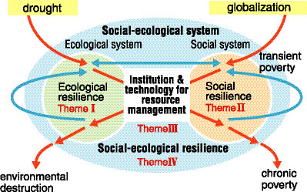
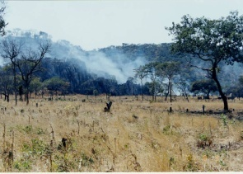
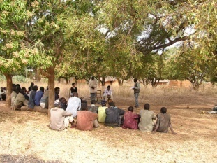
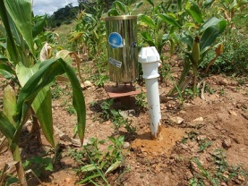
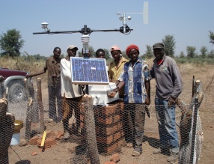
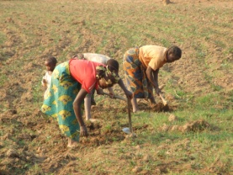
For An Enhancement of Farmer’s Resilience in Zambia and SAT Region
Research Objective
Methodologies & Organization
Research Fields
In-depth examination of livestock production and its role s on enhancing household resilience against shocks is under way in Southern Province.
Inter-relationship between four themes
The resilience project is a theme-based trans-disciplinary research that is organized into four themes. Theme I and II examine resilience of ecological and social system respectively; theme III emphasizes institutional roles; and theme IV combines all themes into an integrated analyses of social-ecological system. Both quantitative and qualitative assessment of social-ecological resilience are used.
An experimental field site is in Eastern Province and an observational field site is in Southern Province.
This project aims at identifying factors affecting resilience and the ways to enhance the resilience of rural small holders in developing countries against environmental variability.
Village meeting for study consent prior to conducting studies in Eastern Province.
Farm-specific rainfall and soil moisture data are collected daily.
Climatic data are comprehensively collected at the study site in Southern Province.
Expected Outcome
Agriculture system is largely a rain-fed system. Maize is Zambia’s primary staple crop.
To evaluate effects of local environmental change on social-ecological systems,
To identify factors that determine a capacity of household and community to recover from shocks, and the role of institutions on strengthening resilience,
To provide policy recommendations on enhancing the resilience of the rural population against environmental variability.
Agricultural production technology is simple and labor intensive.

Slide 2
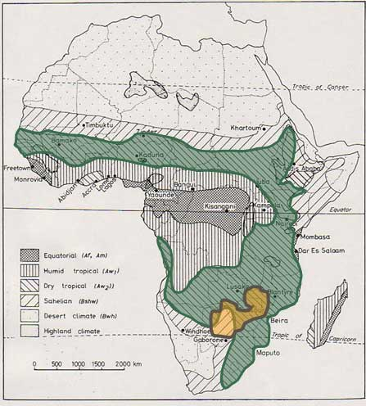
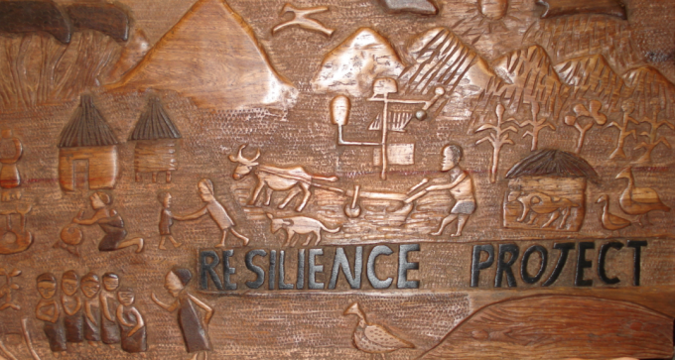


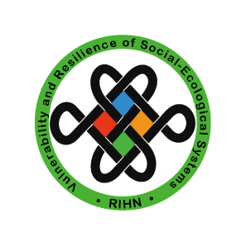
Vulnerability and Resilience of Social-Ecological Systems
RIHN Resilience Project
Research Institute for Humanity and Nature
SAT Region
Project Leader: Chieko Umetsu
Research Period: 2006-2012
Research Corroborators
Japan:
Kyoto Univ., Hokkaido Univ., Ochanomizu Univ.,
Nihon Univ., Hitotsubashi Univ., Iwate Univ.,
National Agricultural Research Center for Tohoku Region,
RESTEC, Survey College of Kinki
International:
Zambia Central Statistical Office,
Zambia Agricultural Research Institute,
University of Zambia,
Zambia Food Security Research Project, MSU
Tamil Nadu Agricultural University, India,
University of Ouagadougou, Burkina Faso
Zambia
What Is Resilience?
Protecting human security of people in the Semi-Arid Tropics (SAT) where people largely depend on vulnerable rain-fed agricultural production systems is an acute issue. Once affected by environmental variability such as climatic or socio-economic shocks, people/households whose livelihood and agricultural production is highly dependent on a natural-resource base need to have an ability to cope and recover to the original pre-shock condition. This ability to withstand shocks without losing its functions and structure and ability to return to its original condition is resilience. Therefore, reducing vulnerability and enhancing resilience are keys to enhance human security of the region. In order to examine the resilience of household in SAT, the resilience of social and ecological system must be jointly considered as an integrated system. We consider resilience to environmental variability, such as drought and flood, and social changes. We consider resilience for protecting human security, i.e. survival, livelihoods and dignity. Finally we consider resilience of food supply and consumption, health status, agricultural production and livelihoods.
SAT Region and the Resilience Project
A vicious cycle of poverty and environmental degradation such as forest degradation and desertification is a major cause of global environmental problems. Especially in semi-arid tropics (SAT) including Sub-Saharan Africa and South Asia where a majority of the poor concentrates, poverty and environmental degradation are prevalent. People in this area depend largely on rain-fed agricultural production systems and their livelihoods are vulnerable to environmental variability. Environmental resources such as vegetation and soil are also vulnerable to human activities. In order to solve these “global environmental issues”, a key is a quick recovery or a resilience of human society and ecosystems against impacts of environmental variability.
National Institutes for the Humanities
Research Institute for Humanity and Nature (RIHN)
457-4 Motoyama, Kamigamo, Kita-ku, Kyoto, 603-8047 JAPAN
Tel.+81-75-707-2100 Fax.+81-75-707-2106
www.chikyu.ac.jp
E-mail: resilience-prj@chikyu.ac.jp
www.chikyu.ac.jp/resilience

